Slide 1

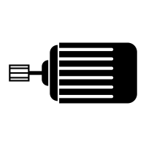
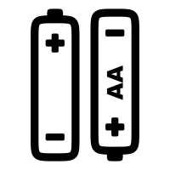
Motor Circuit
Motor
Switch
Positive
Ground
Battery
Pack

Slide 2
H-Bridge
Switch 1
Switch 2
Switch 3
Switch 4
GND
GND

Slide 3
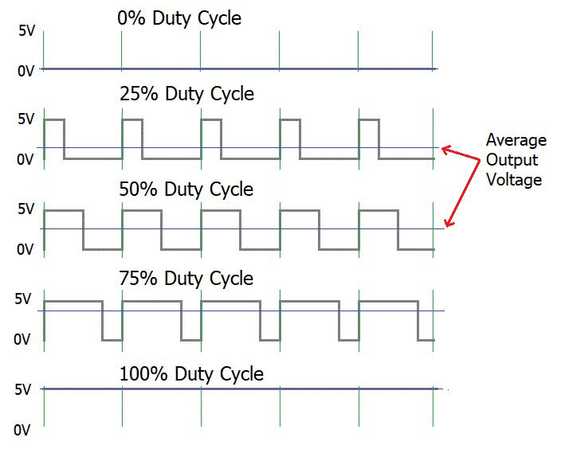
Pulse Width Modulation
Off
Slow
Medium
Fast
Fastest

Slide 4
Motor Controller
Inputs
Outputs
High Power
Motor
Controller
Motor 1
Motor 2
Microcontroller
PWM
High
Power
100 milliamps
Low Power
PWM Signals
1 milliamp

Slide 5
Microcontroller
Inputs (sensors)
Digital Outputs
Microcontroller
LEDs
Digital
Motor
Controller
Program
Speaker
Analog
Data
(RAM)
Display

Slide 6
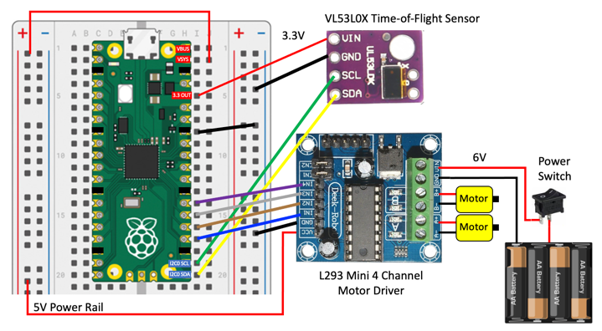
L293D Motor Controller Robot
Use single-chip L293D motor controller board ($2.00) with your microcontroller to create a simple robot
https://www.coderdojotc.org/micropython/robots/02-base-bot/

Slide 7
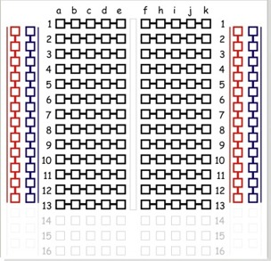
Breadboard
Power Rail
Columns
(Bus Strips)
Red for +5 V
Blue (Black) for GND
numbered rows run across
(horizontal center connections)
Red column for 3.3 V
side columns share ground
and power
(vertical edge connections)
Iinternal row connectors
component slot (center trough)

Slide 8
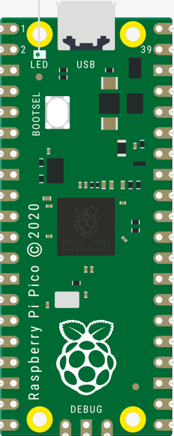
Raspberry Pi Pico
Micro USB Connector
$4.00 at Microcenter in St. Louis Park
Uses the powerful RP2040 microcontroller
264K SRAM (100x Arduino Uno)
2MB flash memory
26 × multi-function digital input or output pins
3 12-bit analogue inputs
16 controllable PWM channels
2 SPI, 2 I2C, and 2 UART channels
Accurate clock and timer on-chip
8 Raspberry Pi Programmable I/O (PIO) state machines
Temperature sensor
Dual core ARM Cortex-M0+ RISC processors
8 × Programmable I/O (PIO) state machines

Slide 9
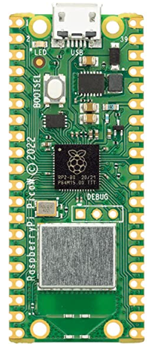
Raspberry Pi Pico W (wireless)
Micro USB Connector
$6.00 at Microcenter in St. Louis Park
All the same features as the Pico plus:
2.4GHz 802.11n wireless LA
Bluetooth will eventually also be supported (libraries missing)
Wireless Chip

Slide 10
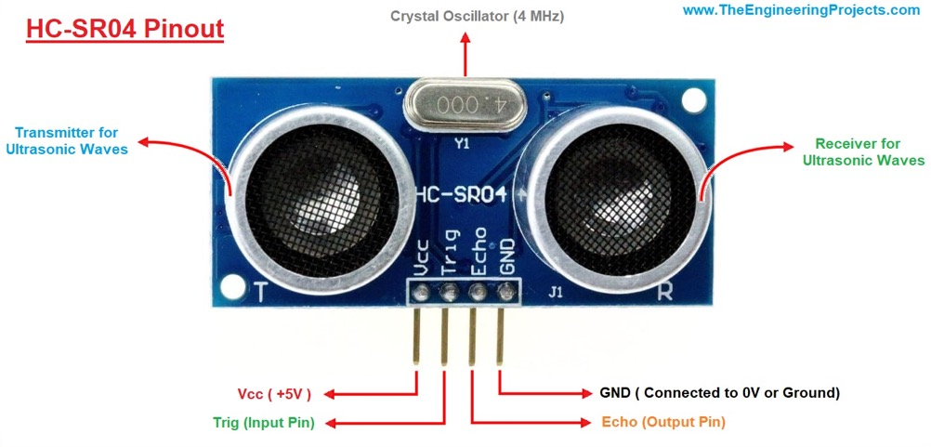
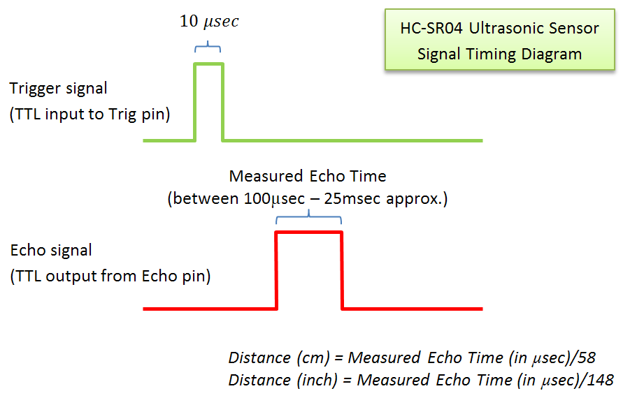
Ultrasonic “Ping” Distance Sensor
HC-SR04 is a low-cost ($3.00 ) ultrasonic distance sensor that you can find for about
The sensors uses “echolocation” to measure the time that a sound pulse takes to bounce off an object
Distance can be calculated from the time sound moves through air

Slide 11
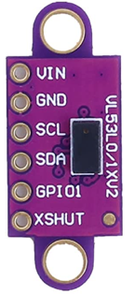
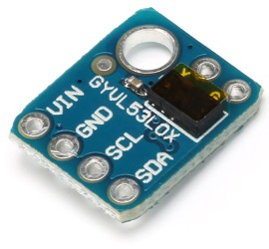
Time-of-Flight Distance Sensor
The VL53L0X is a low-cost ($3.00) time-of-flight sensor sends out a light pulse and measures the time it takes to bounce back
The sensor uses a IIC interface to send distance data to the microcontroller
Light travels about 1 foot every nanosecond so the stopwatch in the sensor must be accurate to the 1/100th of a nanosecond!
photons
Sensor
Emitter
Stopwatch
Receiver
Target
Distance = C * Time
C = speed of light = 186,000 miles per second
2
https://www.coderdojotc.org/micropython/kits/maker-pi-rp2040-robot/10-time-of-flight-lab/

Slide 12
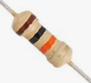
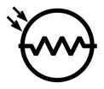
Light Sensor Circuit
ADC_VREF - 3.3 Volts
AGND
10K Resistor
GP26
Photoresistor

Slide 13
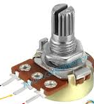
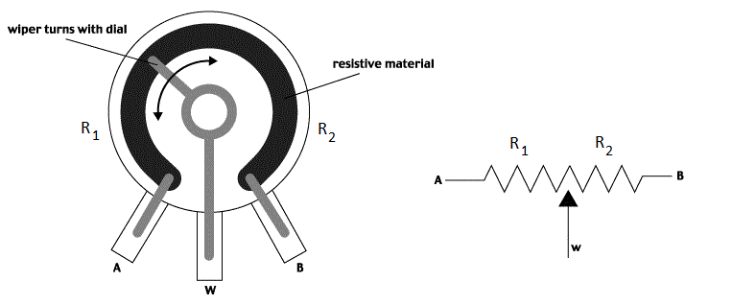
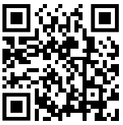
Potentiometer Circuit
ADC_VREF - 3.3 Volts
AGND
GP26
10K Pot
https:// bit.ly/coderdojo-pot-lab
https://www.coderdojotc.org/micropython/sensors/02-pot/

Slide 14
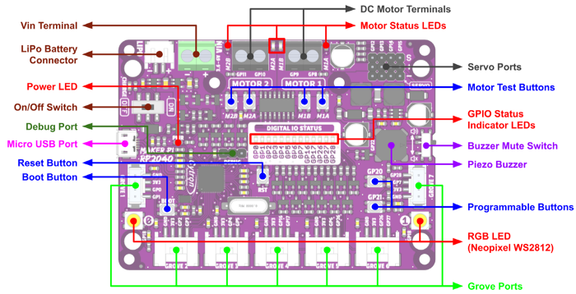
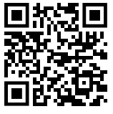
Cytron Maker Pi RP2040
Low-cost board ($12) built around RP2040
Grove ports eliminate the need for any soldering
Many features that make it easy to build fun robots!
https://bit.ly/cytron-maker-pi-rp2040

Slide 15
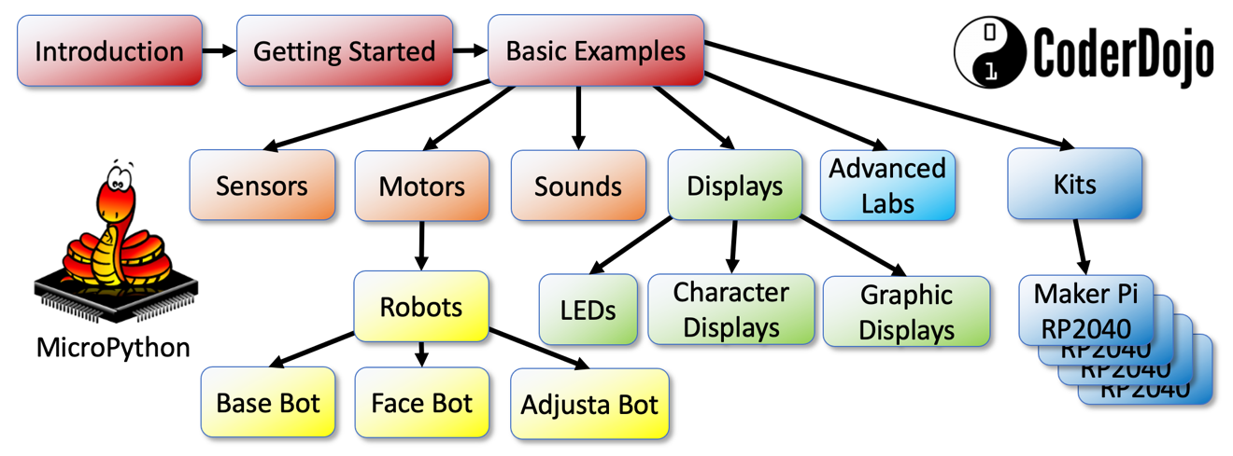
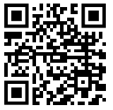
MicroPython
Many robot teaching labs are moving away from C/Arduino to MicroPython
Python is the most popular language in schools and the preferred language for most advanced robotics projects
MicroPython has thousands of drivers and sample code for many devices
https://www.coderdojotc.org/micropython/

Slide 16
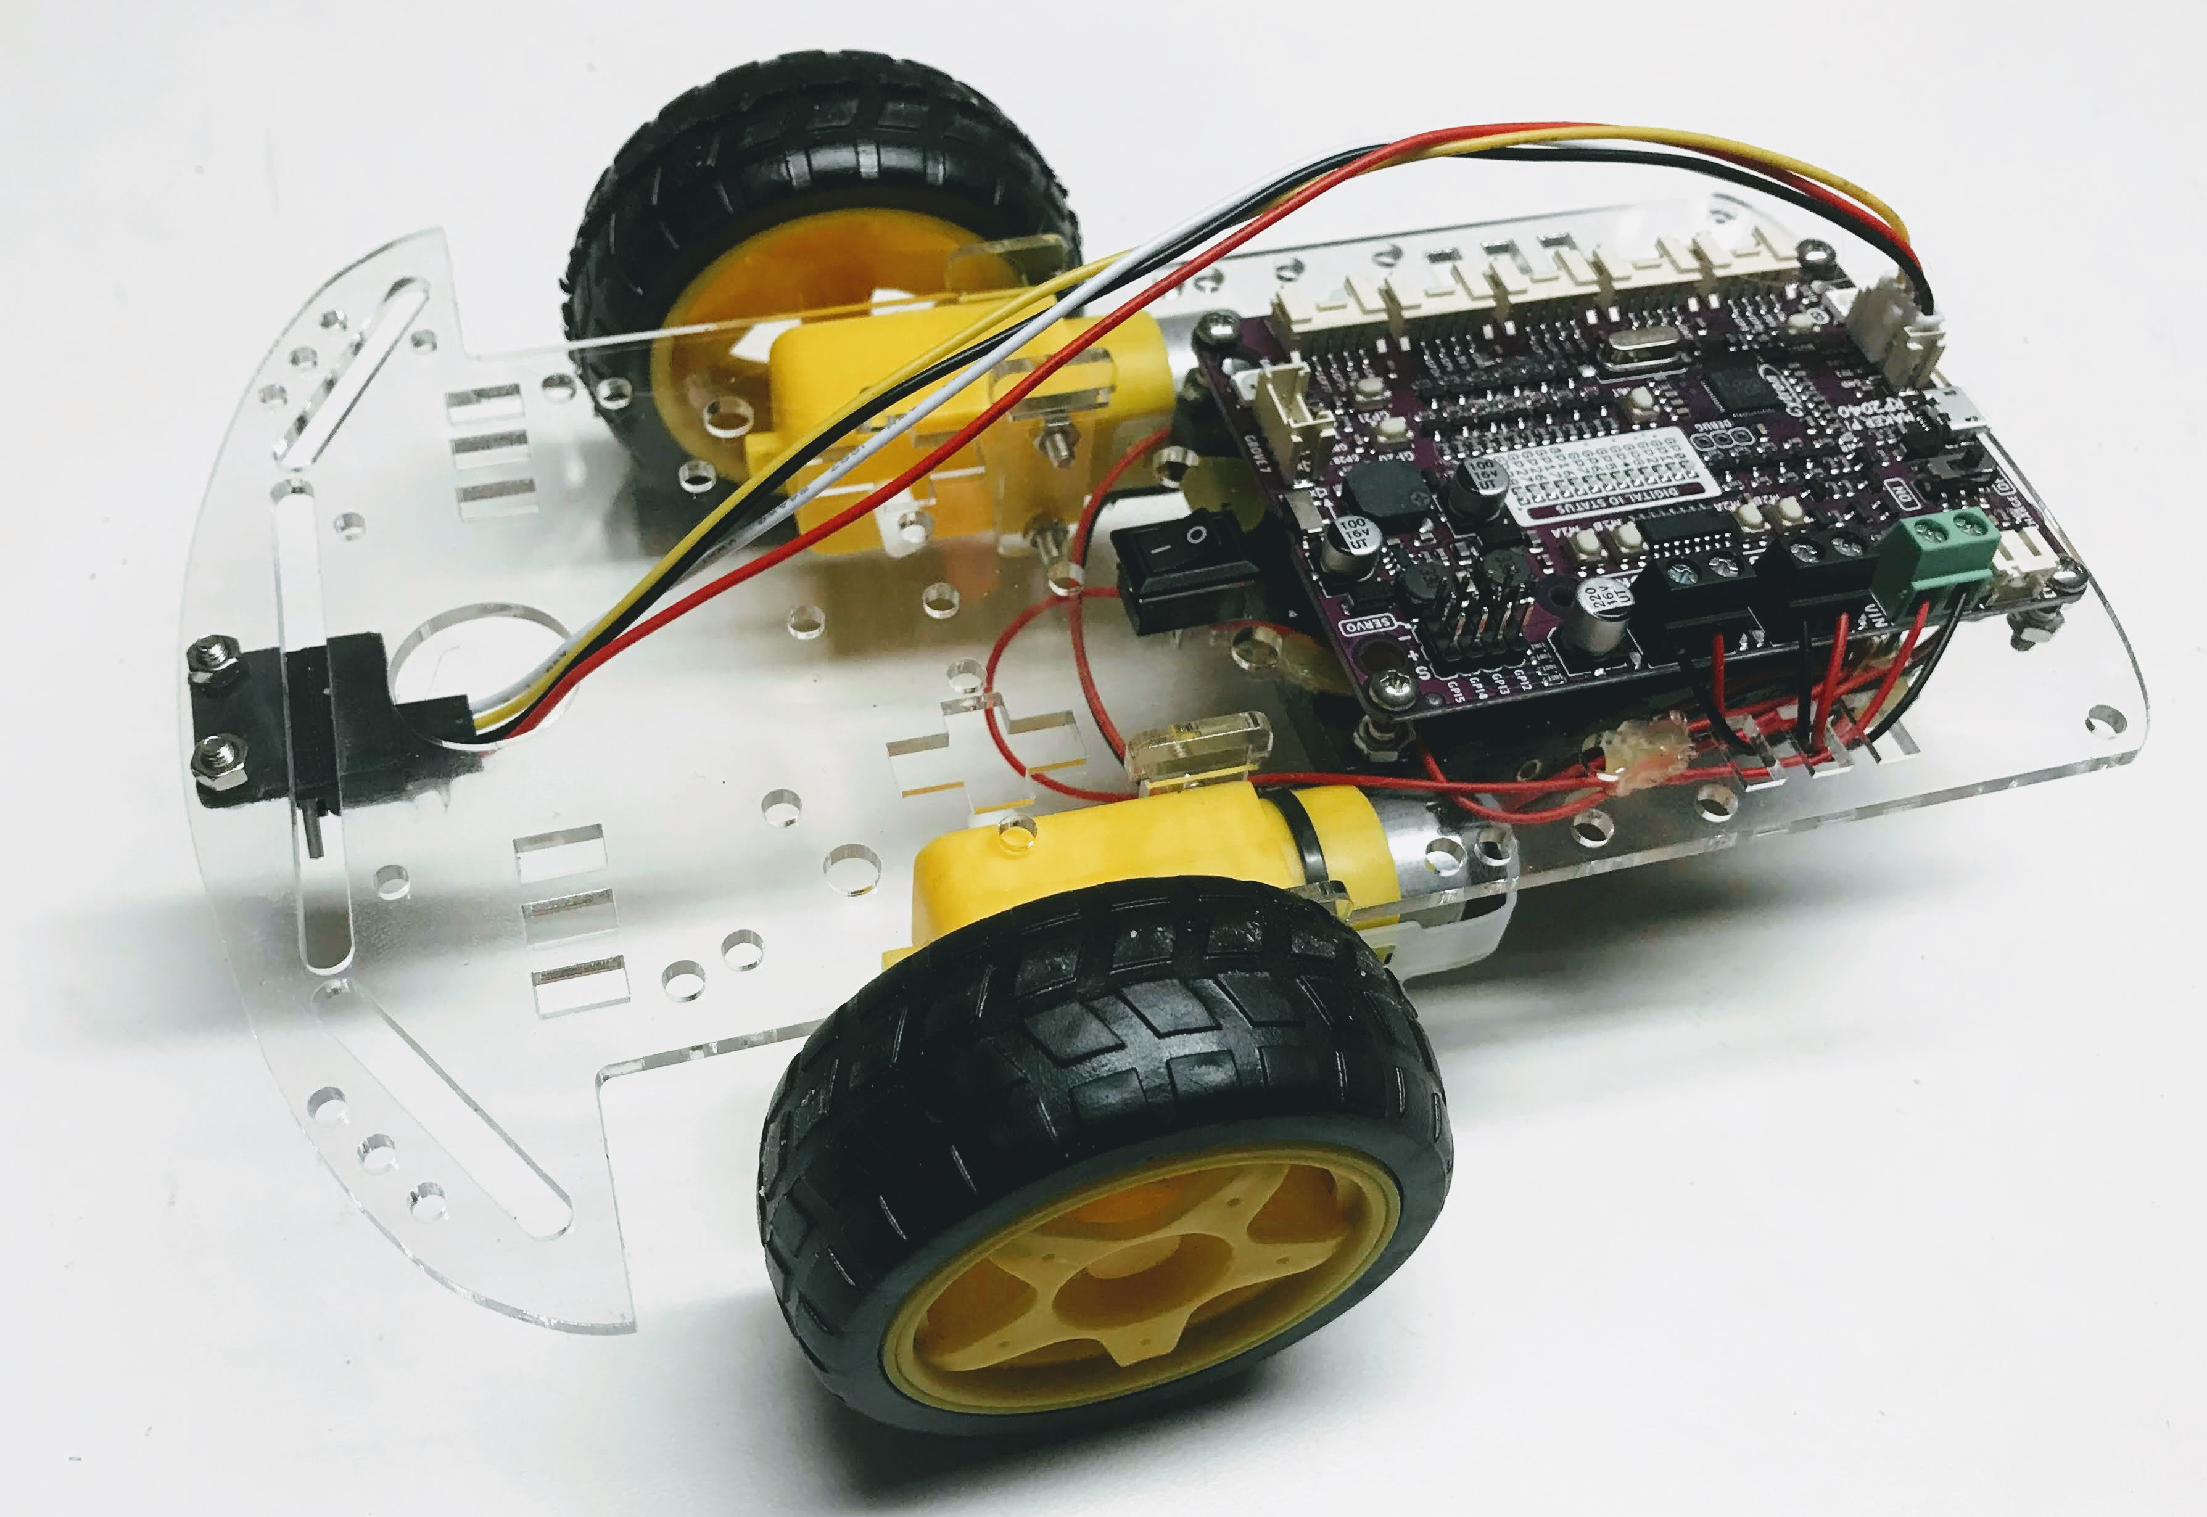
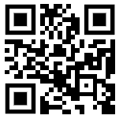
Collision Avoidance Robot
Low-cost (under $20)
Built around the Cytron Maker Pi RP2040 and a “Smart Car” chassis
Hundreds of sample lesson plans using motors, servos, sensors, LEDs and displays in MicroPython
Powered by 4 AA batteries or a rechargeable LiPo battery
Parts guide included
https://bit.ly/coderdojo-robot
https://www.coderdojotc.org/micropython/kits/maker-pi-rp2040-robot/20-collision-avoidance-robot/

Slide 17
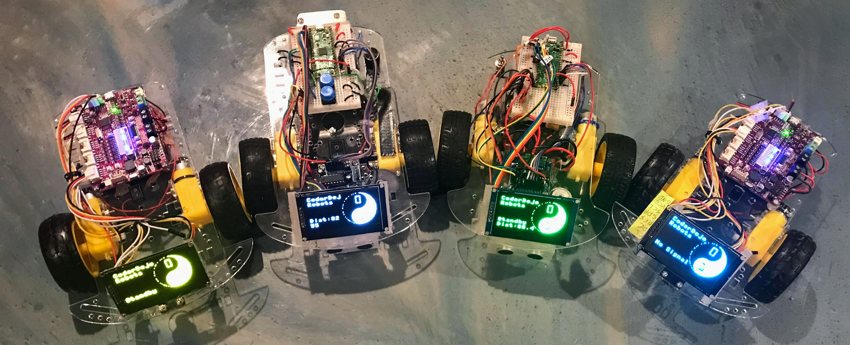
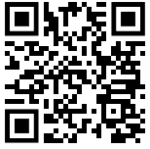
Display Robots
Add an additional OLED display
128x64 resolution
High contrast and easy-to-read display
Can be used with
https://bit.ly/micropython-oleds

Slide 18
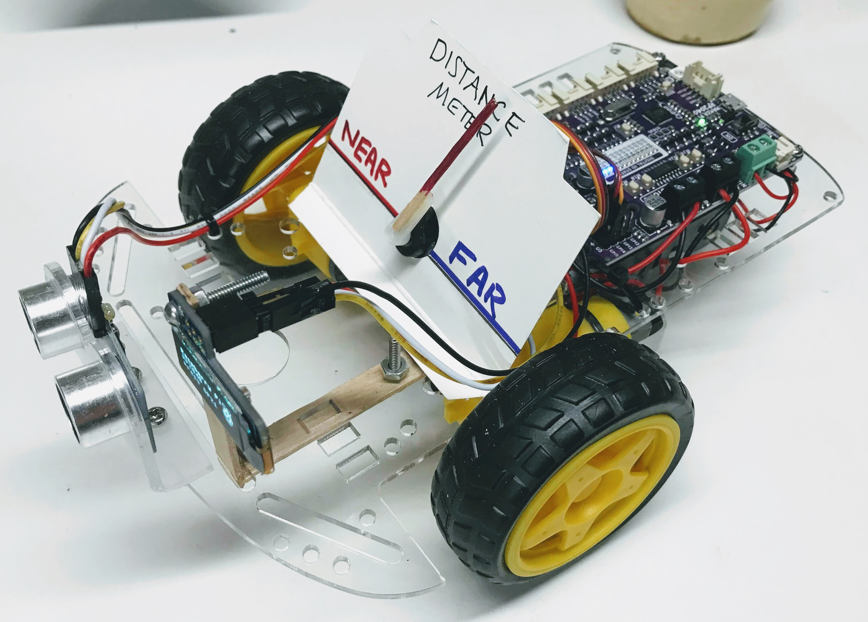
Servo Display Bot
Uses a servo that shows how far the robot is to an obstacle
Includes a small OLED display
https://www.coderdojotc.org/micropython/kits/maker-pi-rp2040-robot/24-ping-servo-meter/

Slide 19

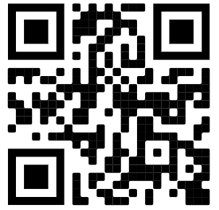



https://www.codesavvy.org/
Code Savvy Explorer Clubs (Coder Dojo Twin Cities and Rebecca Coder Dojo)
Coding Clubs

